Slide 2
Topics
Dictionaries
Sets
Serializing Objects

Slide 3
Dictionaries
Dictionary: object that stores a collection of data
  Each element consists of a key and a value
    Often referred to as mapping of key to value
    Key must be an immutable object
  To retrieve a specific value, use the key associated with it
  Format for creating a dictionary
  dictionary =
  {key1:val1, key2:val2}

Slide 4
Retrieving a Value from a Dictionary
Elements in dictionary are unsorted
General format for retrieving value from dictionary: dictionary[key]
  If key in the dictionary, associated value is returned, otherwise, KeyError exception is raised
Test whether a key is in a dictionary using the in and not in operators
  Helps prevent KeyError exceptions

Slide 5
Adding Elements to an Existing Dictionary
Dictionaries are mutable objects
To add a new key-value pair:
dictionary[key] = value
  If key exists in the dictionary, the value associated with it will be changed

Slide 6
Deleting Elements From an Existing Dictionary
To delete a key-value pair:
del dictionary[key]
  If key is not in the dictionary, KeyError exception is raised

Slide 7
Getting the Number of Elements and Mixing Data Types
len function: used to obtain number of elements in a dictionary
Keys must be immutable objects, but associated values can be any type of object
  One dictionary can include keys of several different immutable types
Values stored in a single dictionary can be of different types

Slide 8
Creating an Empty Dictionary and Using for Loop to Iterate Over a Dictionary
To create an empty dictionary:
  Use {}
  Use built-in function dict()
  Elements can be added to the dictionary as program executes
Use a for loop to iterate over a dictionary
  General format: for key in dictionary:

Slide 9
Some Dictionary Methods
clear method: deletes all the elements in a dictionary, leaving it empty
  Format: dictionary.clear()
get method: gets a value associated with specified key from the dictionary
  Format: dictionary.get(key, default)
    default is returned if key is not found
  Alternative to [] operator
    Cannot raise KeyError exception

Slide 10
Some Dictionary Methods (cont’d.)
items method: returns all the dictionaries keys and associated values
  Format: dictionary.items()
  Returned as a dictionary view
    Each element in dictionary view is a tuple which contains a key and its associated value
    Use a for loop to iterate over the tuples in the sequence
      Can use a variable which receives a tuple, or can use two variables which receive key and value

Slide 11
Some Dictionary Methods (cont’d.)
keys method: returns all the dictionaries keys as a sequence
  Format: dictionary.keys()
pop method: returns value associated with specified key and removes that key-value pair from the dictionary
  Format: dictionary.pop(key, default)
    default is returned if key is not found

Slide 12
Some Dictionary Methods (cont’d.)
popitem method: returns a randomly selected key-value pair and removes that key-value pair from the dictionary
  Format: dictionary.popitem()
  Key-value pair returned as a tuple
values method: returns all the dictionaries values as a sequence
  Format: dictionary.values()
  Use a for loop to iterate over the values

Slide 13
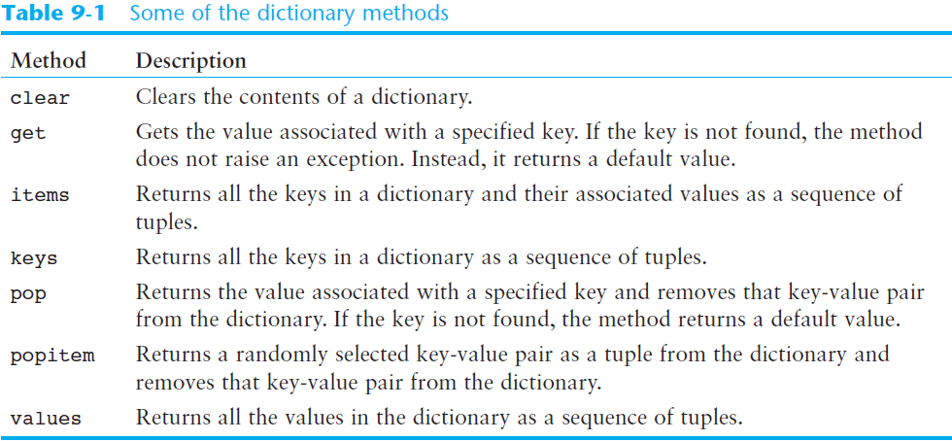
Some Dictionary Methods (cont’d.)

Slide 14
Sets
Set: object that stores a collection of data in same way as mathematical set
  All items must be unique
  Set is unordered
  Elements can be of different data types

Slide 15
Creating a Set
set function: used to create a set
  For empty set, call set()
  For non-empty set, call set(argument) where argument is an object that contains iterable elements
    e.g., argument can be a list, string, or tuple
    If argument is a string, each character becomes a set element
      For set of strings, pass them to the function as a list
    If argument contains duplicates, only one of the duplicates will appear in the set

Slide 16
Getting the Number of and Adding Elements
len function: returns the number of elements in the set
Sets are mutable objects
add method: adds an element to a set
update method: adds a group of elements to a set
  Argument must be a sequence containing iterable elements, and each of the elements is added to the set

Slide 17
Deleting Elements From a Set
remove and discard methods: remove the specified item from the set
  The item that should be removed is passed to both methods as an argument
  Behave differently when the specified item is not found in the set
    remove method raises a KeyError exception
    discard method does not raise an exception
clear method: clears all the elements of the set

Slide 18
Using the for Loop, in, and not in Operators With a Set
A for loop can be used to iterate over elements in a set
  General format: for item in set:
  The loop iterates once for each element in the set
The in operator can be used to test whether a value exists in a set
  Similarly, the not in operator can be used to test whether a value does not exist in a set

Slide 19
Finding the Union of Sets
Union of two sets: a set that contains all the elements of both sets
To find the union of two sets:
  Use the union method
    Format: set1.union(set2)
  Use the | operator
    Format: set1 | set2
  Both techniques return a new set which contains the union of both sets

Slide 20
Finding the Intersection of Sets
Intersection of two sets: a set that contains only the elements found in both sets
To find the intersection of two sets:
  Use the intersection method
    Format: set1.intersection(set2)
  Use the & operator
    Format: set1 & set2
  Both techniques return a new set which contains the intersection of both sets

Slide 21
Finding the Difference of Sets
Difference of two sets: a set that contains the elements that appear in the first set but do not appear in the second set
To find the difference of two sets:
  Use the difference method
    Format: set1.difference(set2)
  Use the - operator
    Format: set1 - set2

Slide 22
Finding the Symmetric Difference of Sets
Symmetric difference of two sets: a set that contains the elements that are not shared by the two sets
To find the symmetric difference of two sets:
  Use the symmetric_difference method
    Format: set1.symmetric_difference(set2)
  Use the ^ operator
    Format: set1 ^ set2

Slide 23
Finding Subsets and Supersets
Set A is subset of set B if all the elements in set A are included in set B
To determine whether set A is subset of set B
  Use the issubset method
    Format: setA.issubset(setB)
  Use the <= operator
    Format: setA <= setB

Slide 24
Finding Subsets and Supersets (cont’d.)
Set A is superset of set B if it contains all the elements of set B
To determine whether set A is superset of set B
  Use the issuperset method
    Format: setA.issuperset(setB)
  Use the >= operator
    Format: setA >= setB

Slide 25
Serializing Objects
Serialize an object: convert the object to a stream of bytes that can easily be stored in a file
Pickling: serializing an object

Slide 26
Serializing Objects (cont’d.)
To pickle an object:
  Import the pickle module
  Open a file for binary writing
  Call the pickle.dump function
    Format: pickle.dump(object, file)
  Close the file
You can pickle multiple objects to one file prior to closing the file

Slide 27
Serializing Objects (cont’d.)
Unpickling: retrieving pickled object
To unpickle an object:
  Import the pickle module
  Open a file for binary writing
  Call the pickle.load function
    Format: pickle.load(file)
  Close the file
You can unpickle multiple objects from the file

Slide 28
Summary
This chapter covered:
  Dictionaries, including:
    Creating dictionaries
    Inserting, retrieving, adding, and deleting key-value pairs
    for loops and in and not in operators
    Dictionary methods

Slide 29
Summary (cont’d.)
This chapter covered (cont’d):
  Sets:
    Creating sets
    Adding elements to and removing elements from sets
    Finding set union, intersection, difference and symmetric difference
    Finding subsets and supersets
  Serializing objects
    Pickling and unpickling objects

